Slide 1

AI Agents &
Integrations
Hector Triana

Slide 2
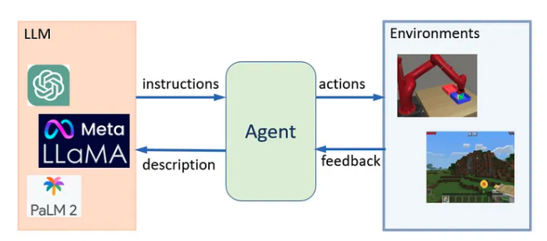

What is an AI Agent?
An AI or LLM agent is a software entity that autonomously performs tasks based on input, environmental factors, and predefined goals. These agents leverage AI models and can act, respond, learn, and adapt over time. This type of AI system that goes beyond simple text production. It uses a large language model (LLM) as its central computational engine, allowing it to carry on conversations, do tasks, reason, and display a degree of autonomy.
Carefully crafted prompts that encode identities, instructions, authorization, and context guide LLM agents and shape their replies and activities.

Slide 3
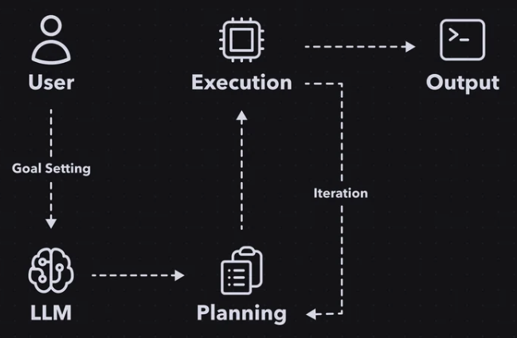
How AI Agents Work
1. Goal Setting
The user feeds the desired objective to the AI agent. These are the instructions the AI will use to complete its mission.
2. Task Planning
The AI Agent interprets the user’s needs and gets to work processing the request. Based on the goal the AI agent creates a list of tasks that need to be completed. It also determines the sequence in which these tasks should be executed to efficiently achieve the goal.
This is the basic framework the AI uses as it moves onto step 3 of the process.
3. Execution
This is the step that sets AI Agents apart from regular Chatbots. With the list of tasks planned out, the AI agent sources data from the internet, exactly how you or I would.
It will find and compare information to determine the best outcome, iterating the original task list as more information becomes available. The AI Agent can add extra goals, modify existing goals, or mark goals as complete.
Once all tasks are complete and the objective is fulfilled, the AI agent’s workflow concludes. At this point, it has successfully achieved what it set out to accomplish, and the user can review the output.
Alt text: A diagram with icons showing the user, the LLM, a list for task planning, and a cloud representing execution. Each icon is connected by an arrow. There is an iteration arrow between the execution and task planning.

Slide 4
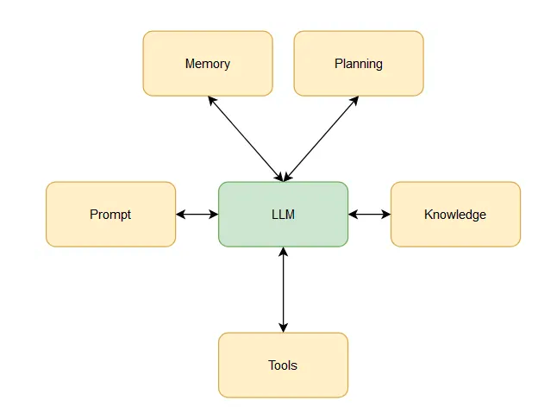
While memory is concerned with retaining user interactions and specific task-related details over a temporal framework, knowledge represents broader expertise that can be applied across different users and tasks.
Key Components
Short-term memory, which is central to the Large Language Model (LLM) and ensures that we never lose track of ongoing conversations or our most recent acts. This agent's short-term memory serves as a shifting context window, helping it make sense in current conversations.
Complex problems often need a chain-of-thought approaches. Agents forms a plan by using a combination of two methods:
Task and question decomposition: Breaking down the task or question into smaller parts
Reflection or critic: Frameworks such as React are used to critic the plan generated by the agent
Specialized knowledge is a crucial facet that supplements the core architecture of AI. It introduces domain-specific terminologies, concepts, and modes of reasoning that are finely tuned to particular topics or fields.
Long-term memory, where an external database is combined with the LLM to greatly increase the LLM's ability to remember voluminous amounts of data. This enhancement broadens the agent's memory to include information, conversations, and other things from a longer period.
Commonsense knowledge is another dimension that enriches the AI's capabilities. It imparts a general understanding of the world that the model might lack by introducing facts and insights about society, culture, science, and various other domains.
Procedural knowledge equips the AI with the practical skills and methods required to accomplish specific tasks. Whether understanding complex workflows, employing analytical techniques, or engaging in creative processes, procedural knowledge empowers the AI to provide practical guidance and solutions.
Prompt recipes that activate and direct the LLM's abilities are also crucial. The agent's identity, expertise, behaviours, and objectives are all imparted to it using carefully prepared prompts. Prompt recipes provide pre-defined templates that combine important instructions, contexts, and parameters to elicit the necessary agent answers.
The LLM agent's foundation is the large language model upon which it is built. This neural network, trained using massive datasets, can generate and understand simple texts. The LLM's size and design set the agent's initial capabilities and constraints.
Integration of tools allows agents to carry out their duties using other services and APIs rather than relying entirely on language generation. For instance, a code interpreter like OpenAi's could be used by an agent as a code execution tool to carry out software operations mentioned in a prompt.

Slide 5
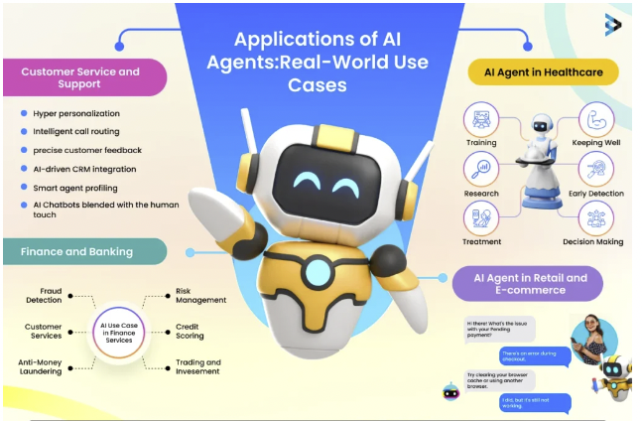
Classifications
By Functionality:
Information Gathering Agents: Agents that search, gather, and process information. Example: Web crawlers or data aggregation bots.
Interface Agents: These interact with users and act as a bridge between humans and software applications. Example: Chatbots and voice assistants.
Collaborative Agents: Work in multi-agent systems where multiple agents work together. Example: Distributed AI agents for optimizing network resources.
By Learning Ability:
Fixed Agents: Operate based on a set of static rules and do not learn or adapt. Useful for predictable, structured tasks.
Learning Agents: Use data to learn and improve over time, often leveraging reinforcement learning or supervised learning.
By Autonomy Level:
Assistive Agents: These help users with specific tasks but require direct input or supervision.
Autonomous Agents: Work independently and make decisions based on the environment, often seen in robotics and self-driving cars.

Slide 6
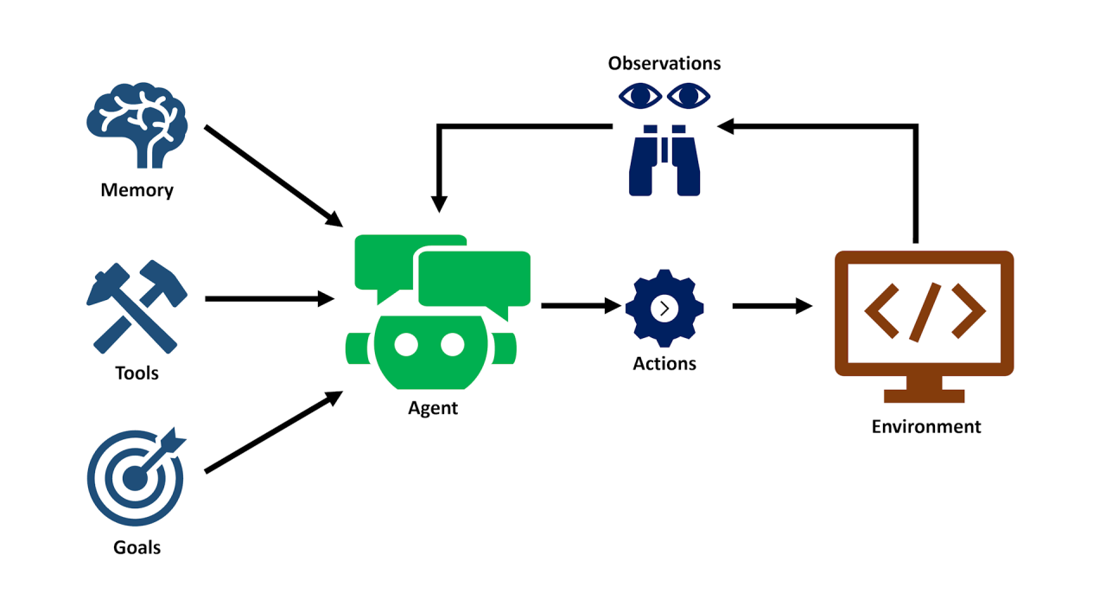
AI Agent Integration
Frontend: Where users interact with the AI agent (e.g., website chatbot, mobile app).
API Gateway: Manages and routes requests from the frontend to the backend.
Backend Server: Processes requests, manages interactions with the AI model, and handles data storage.
AI Model Service: Connects to the AI provider (e.g., OpenAI, Hugging Face) to process user queries and receive responses.
Database: Stores user data, past interactions, and configuration settings if needed.

Slide 7
AI Agents Integration: configuration
Define the Purpose: Before configuring the AI, clearly define the agent’s goals (e.g., providing customer support, recommending products, answering FAQs).
Adjusting Model Parameters:
Temperature: Controls the creativity of responses. Higher values (e.g., 1.0) produce more diverse outputs, while lower values produce more deterministic responses.
Max Tokens: Limits the length of the response, useful for concise or detailed answers.
Top-p (Nucleus Sampling): Limits token selection to the top-p percent, balancing response diversity. This defines defines the probabilistic sum of tokens that should be considered for each subsequent token. Top P's values span from 0.0 to 1.0.
Prompt Engineering:
Write prompts tailored to specific tasks or responses (e.g., “Explain this product’s features” or “Provide a friendly greeting”).
Test and iterate on prompts to achieve desired outputs.
Fine-Tuning (if available): For highly specialized tasks, fine-tune the AI model with custom data to improve relevance and accuracy for the specific use case.

Slide 8
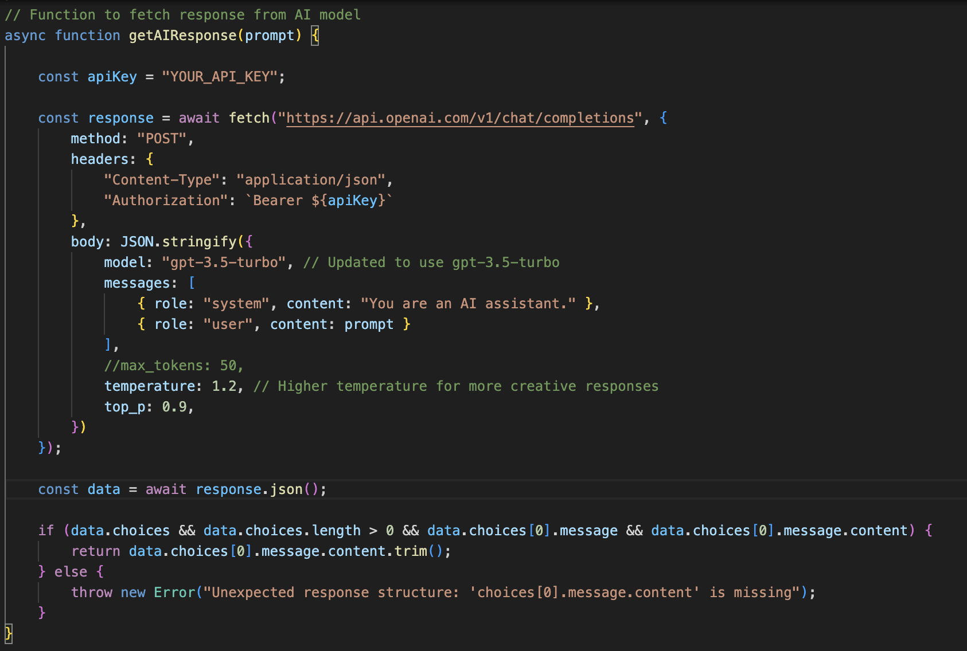

Slide 9
Hands-On Exercises with AI Agents
Basic Chatbot
Objective: Set up a simple chatbot that responds to user questions on a website.
Instructions:
Use HTML for the frontend chat interface.
Use JavaScript to send user inputs to an AI model API (e.g., OpenAI’s API) and display responses.
Expected Outcome: A working chatbot on a webpage that answers general questions.
Exercise 2 (Medium): Product Recommendation Agent
Objective: Create an AI agent that recommends products based on user preferences.
Instructions:
Build a form on the frontend where users enter their preferences (e.g., price range, category).
Use the backend to process the data and send a structured prompt to an AI model for recommendations.
Display the recommended products on the frontend.
Expected Outcome: The agent provides personalized product recommendations.
Exercise 3 (Hard): Task Automation Agent
Objective: Create an AI agent that performs a sequence of tasks based on user instructions.
Instructions:
Build a web interface where users can enter tasks they want automated (e.g., “Send a report email every morning”).
Configure the backend to interpret the instruction and simulate task automation using an AI model (e.g., generating email templates).
Expected Outcome: An agent that can understand multi-step tasks and simulate their execution.

Slide 10
Reference Links
https://medium.com/@aydinKerem/what-is-an-llm-agent-and-how-does-it-work-1d4d9e4381ca
https://www.ionio.ai/blog/what-is-llm-agent-ultimate-guide-to-llm-agent-with-technical-breakdown
https://stablecog.com/blog/what-is-an-ai-agent
https://www.brainvire.com/blog/understanding-ai-agents-features-applications-and-deployment/
https://www.linkedin.com/pulse/agent-ai-new-era-intelligent-app-development-tarun-sharma-laffc/
https://platform.openai.com/docs/overview
https://zapier.com/blog/claude-api/
https://docs.anthropic.com/en/api/getting-started

Slide 11


